Slide 1
Notes:
DON’T FORGET TO START DATABRICKS CLUSTER!!!!!

Slide 2
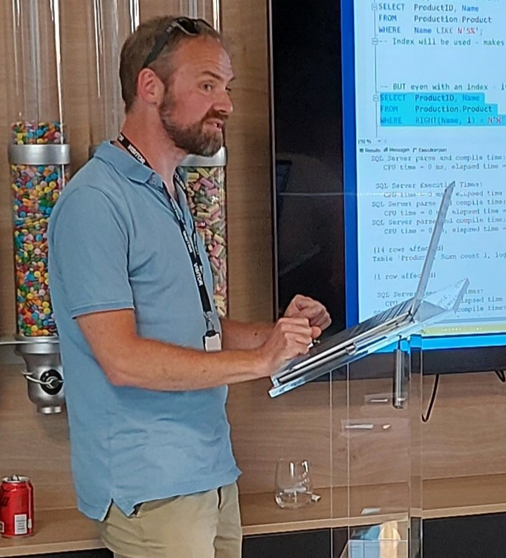

Phil Austin
Senior Consultant

Slide 3
Azure
Go to Azure.com
Click ‘Try Azure for free’
You will need:
An email address
A mobile phone
A credit/debit card – don’t worry you won’t be charged!
Choose United Kingdom or US region
$200 credit / 30 days
Some resources are free longer / permanently

Slide 4
Data engineering using your free credits
Resource group

Slide 5

Data engineering using your free credits
SQL Server
Resource group

Slide 6

Data engineering using your free credits
SQL Server
Data Factory
Resource group

Slide 7

Data engineering using your free credits
SQL Server
Data Factory
Storage Account
Resource group

Slide 8

Data engineering using your free credits
Res
SQL Server
Data Factory
Storage Account
Databricks
Resource group

Slide 9
VS Code
Free download
Very large number of plug-ins/extensions – most free

Slide 10
Azure CLI
Install by following links from: https://learn.microsoft.com/en-us/cli/azure/install-azure-cli
For VS Code:
Azure CLI Tools
Azure Developer CLI

Slide 11
Azure Portal

Slide 12
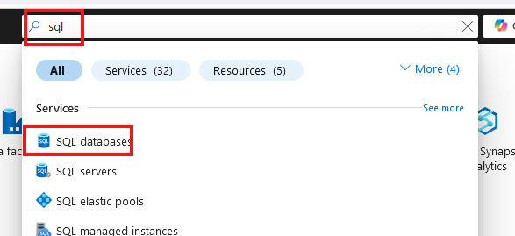
Create SQL database

Slide 13
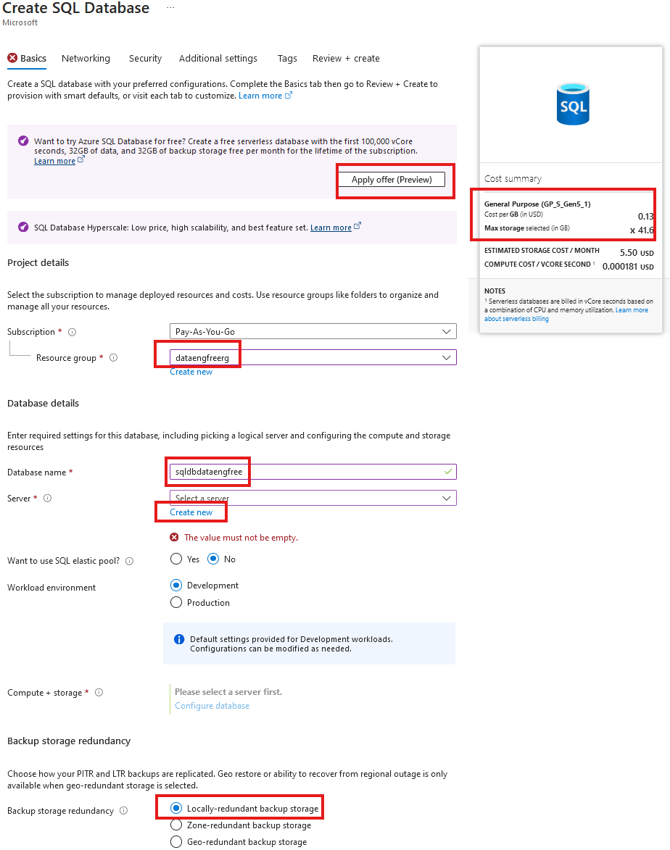
Create SQL database

Slide 14
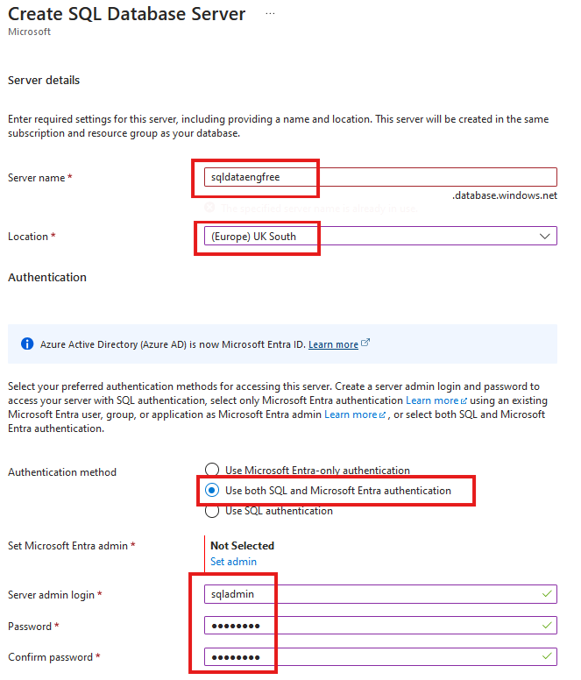
Create SQL database

Slide 15
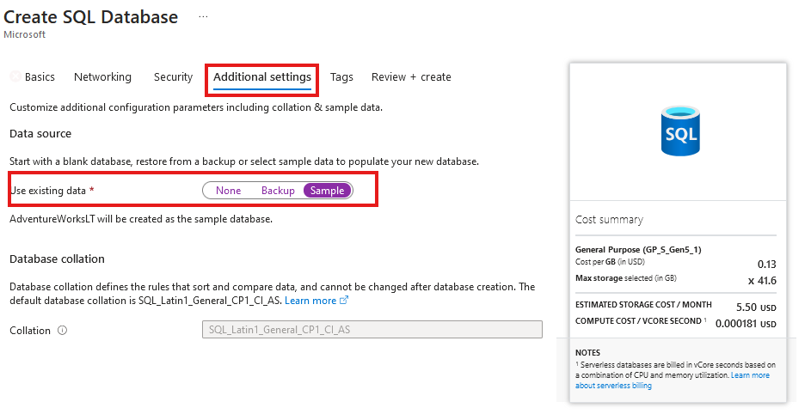
Create SQL database
Add sample data

Slide 16
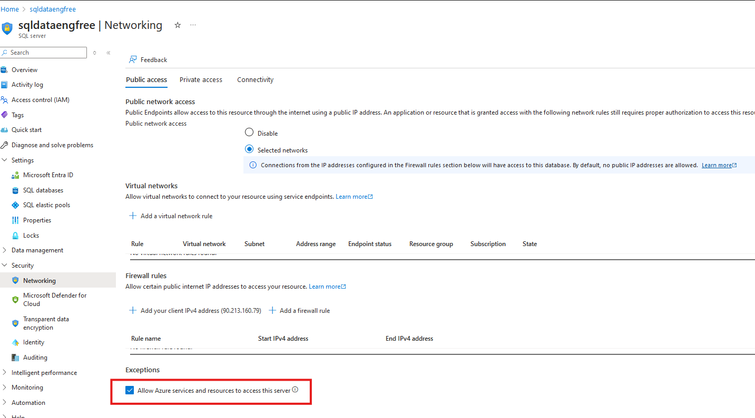

Slide 17
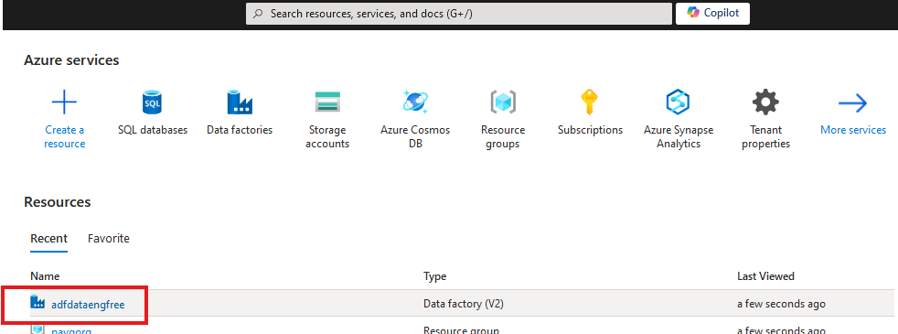


Slide 18
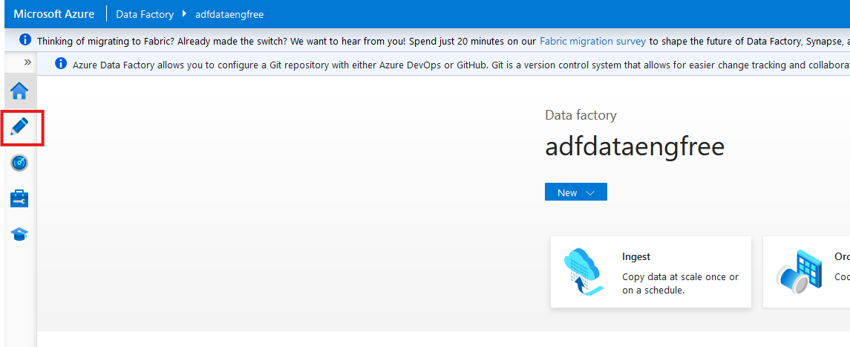

Slide 19
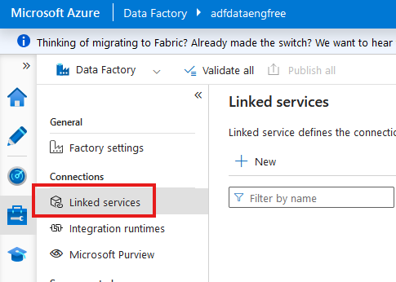

Slide 20
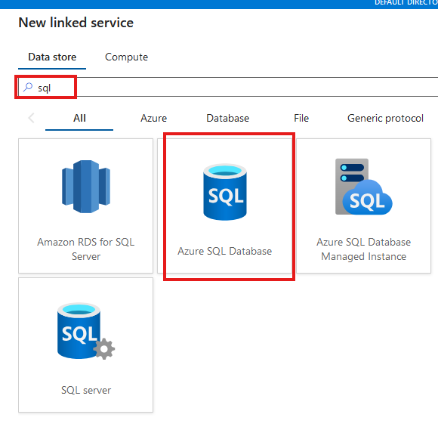

Slide 21
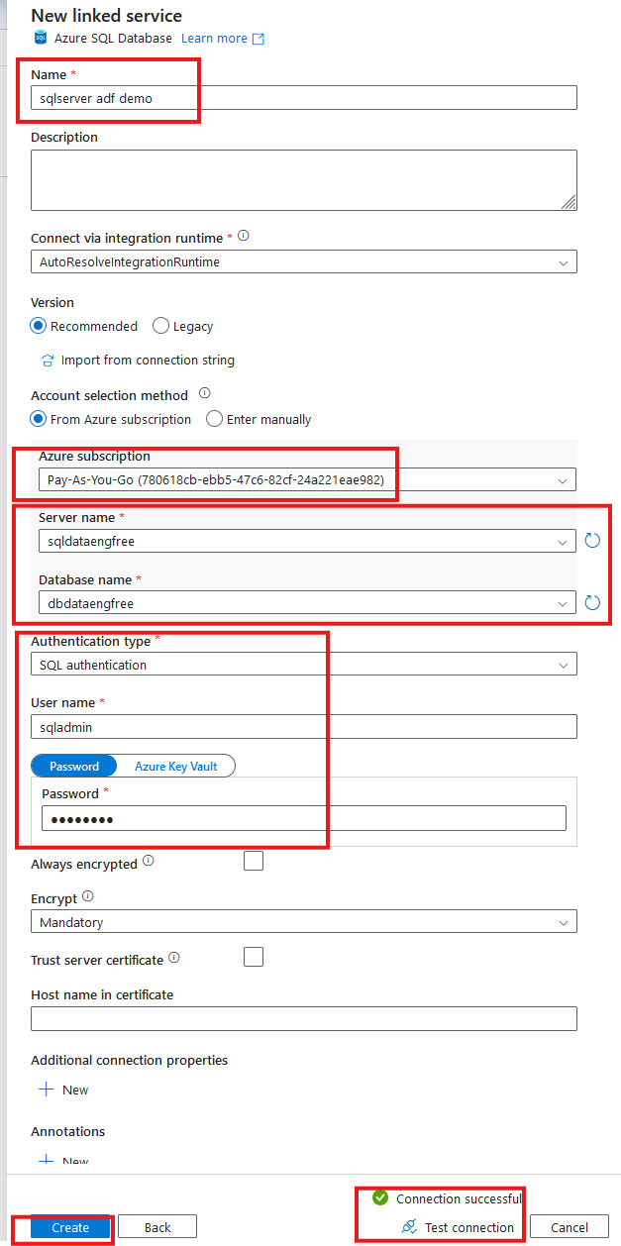

Slide 22
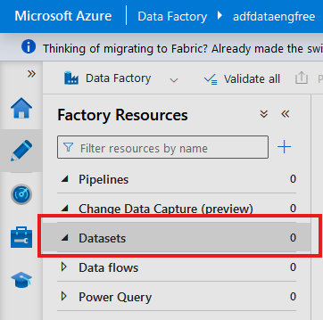
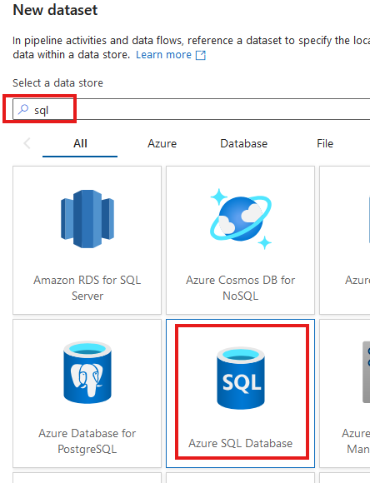

Slide 23
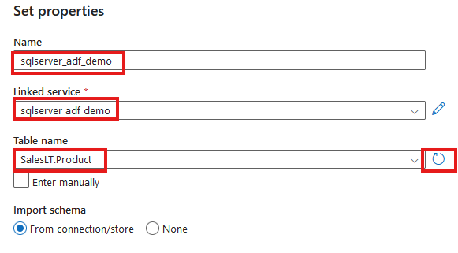

Slide 24
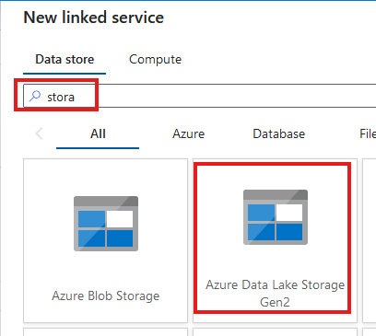
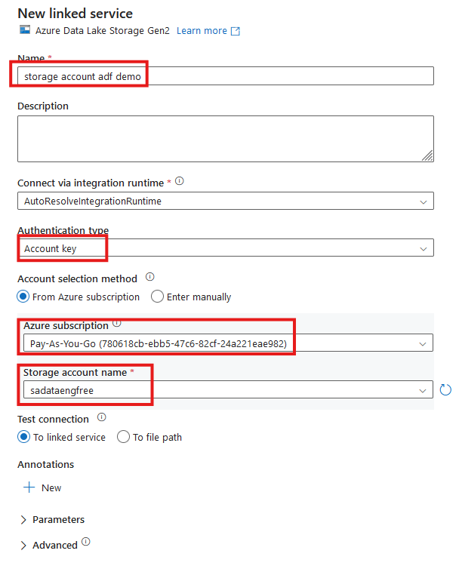


Slide 25
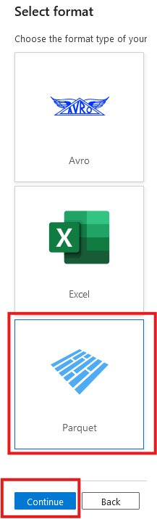
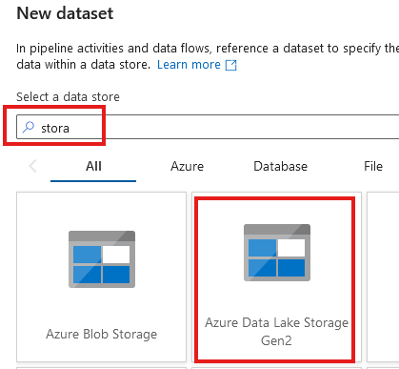

Slide 26
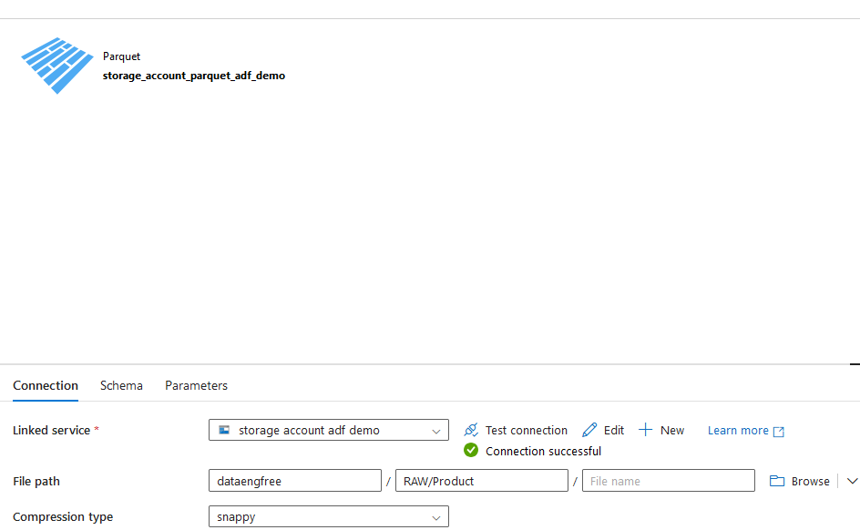

Slide 27
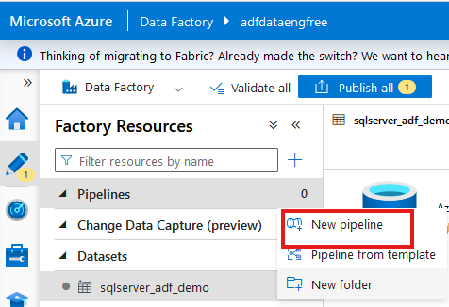
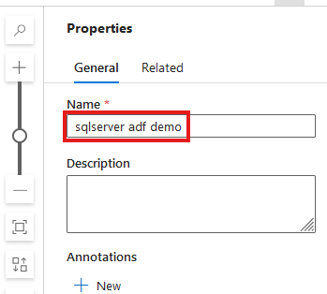

Slide 28
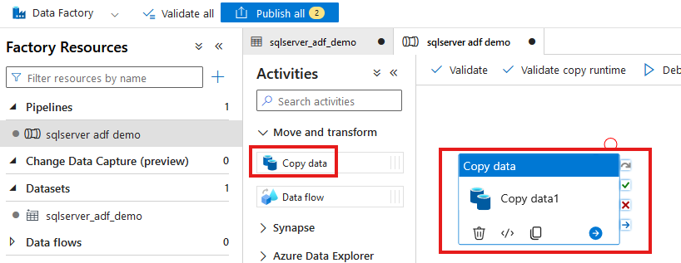

Slide 29
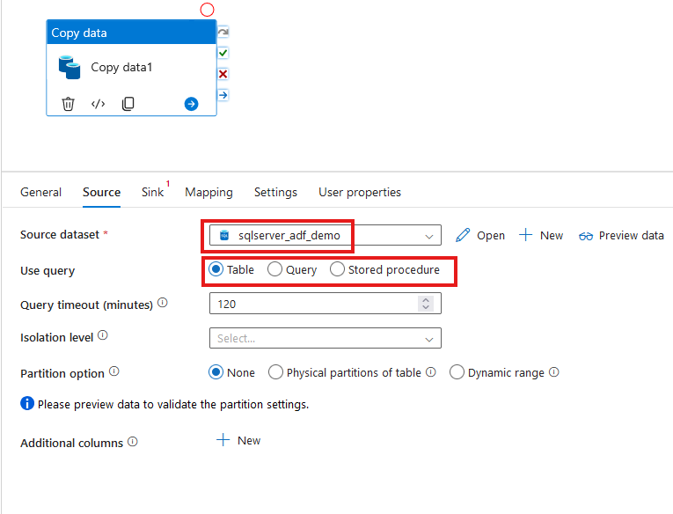

Slide 30
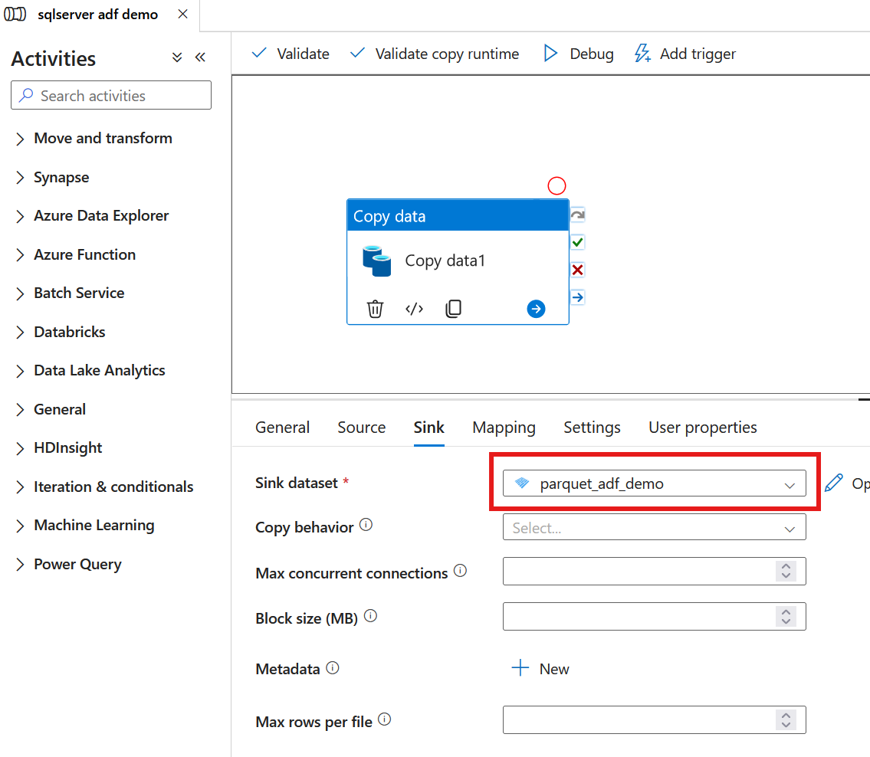

Slide 31
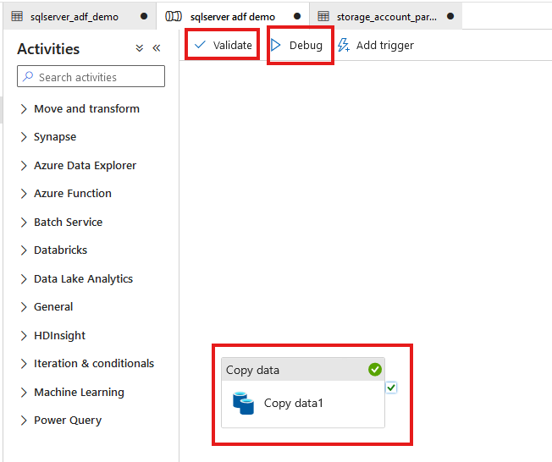

Slide 32
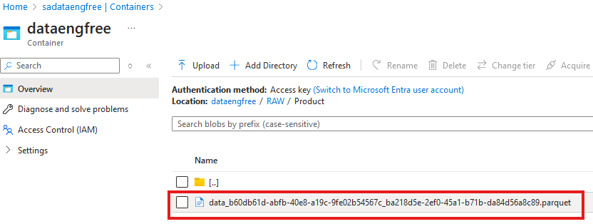

Slide 33
Azure CLI Part II

Slide 34
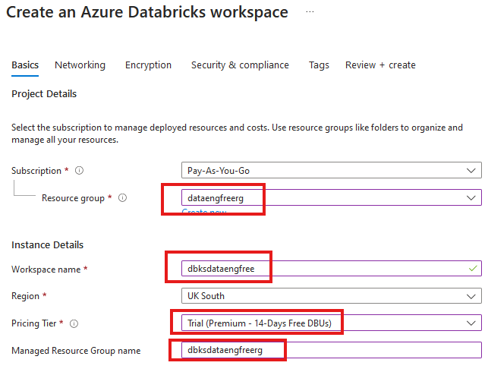


Slide 35
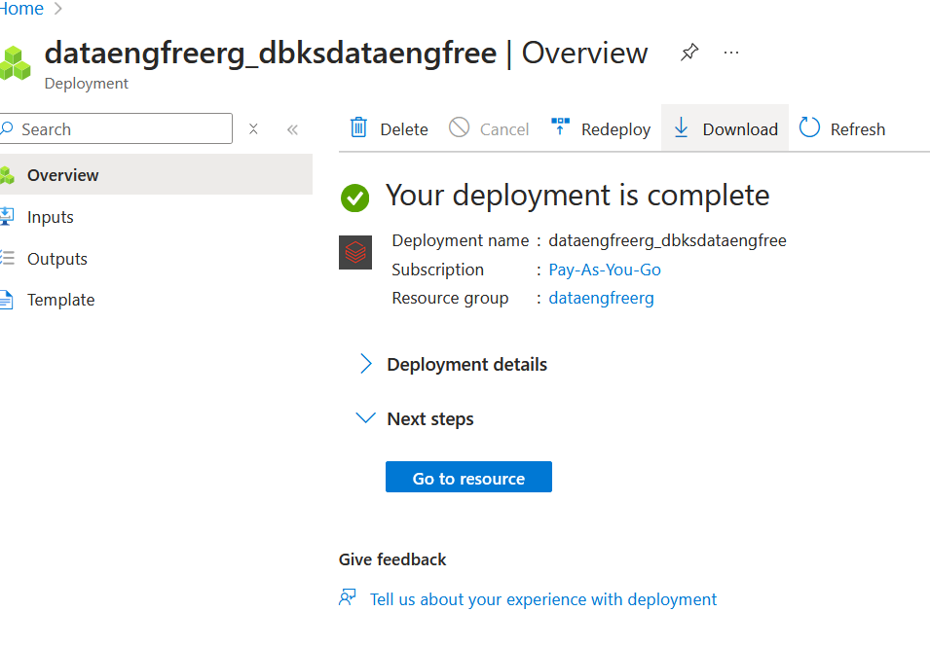

Slide 36
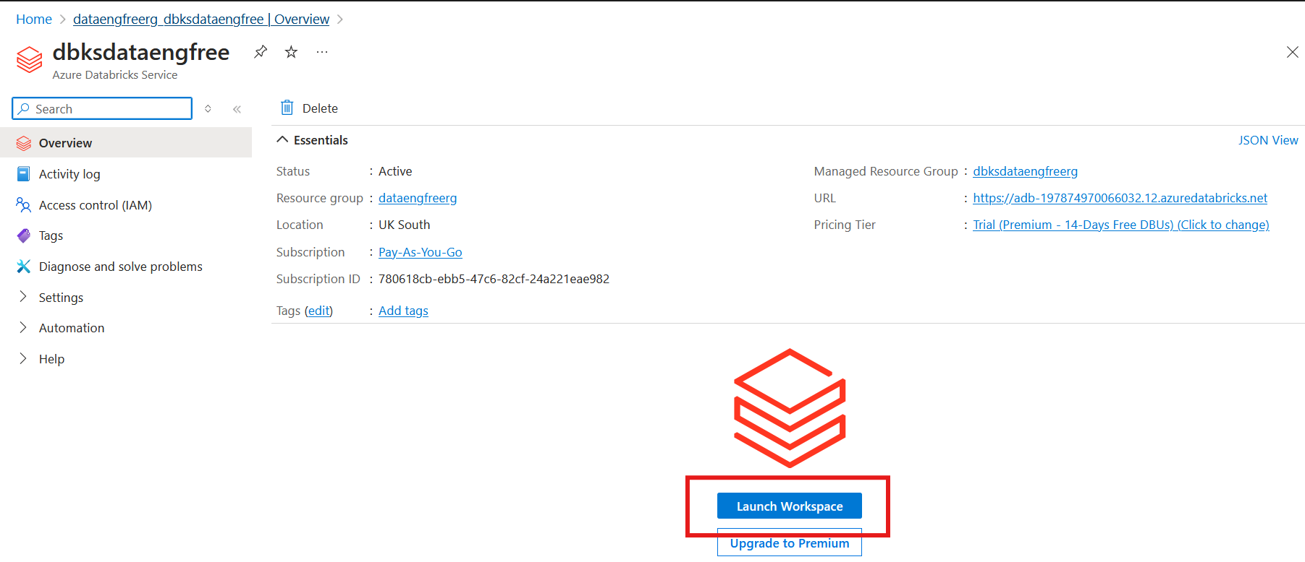

Slide 37
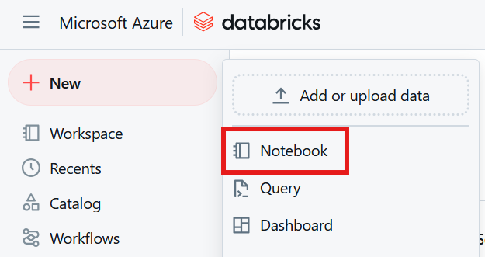

Slide 38
Databricks Demo

Slide 39
Python
Use Anaconda
Use conda to create environment
Might need to enable Long Paths

Slide 40
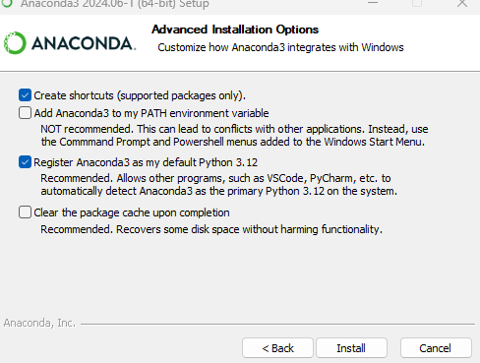
Anaconda install

Slide 41
Conda demo

Slide 42
PySpark Pre-requisites
Install Java (not v 21)
Set paths
JAVA_HOME
PATH
Install Apache Spark
Install winutils.exe
Create virtual environment
Instructions: https://sparkbyexamples.com/pyspark-tutorial/

Slide 43
PySpark Demo
Notes:
PySpark validation
Web UI
VS Code
- to run Jupiter notebooks needs ipykernel installed
- from vscode run conda install -n dataengforfree_env ipykernel
- copy python.exe > python3.exe
Visualisation?

Slide 44
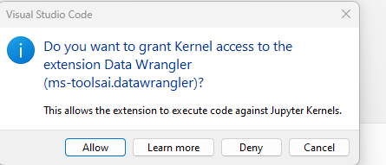

Slide 45
Follow-up Resources
Repo: https://github.com/phil-a10/Talks/tree/main/Data%20Engineering%20Using%20Free%20Tools
Microsoft Learn: https://learn.microsoft.com/en-us/training/career-paths/data-engineer
Kimball books
Downloads
Azure CLI: https://learn.microsoft.com/en-us/cli/azure/install-azure-cli

Slide 46
END

Slide 47
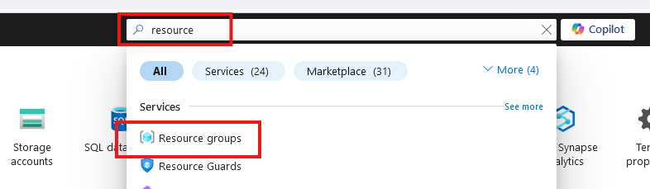
Create Resource Group

Slide 48
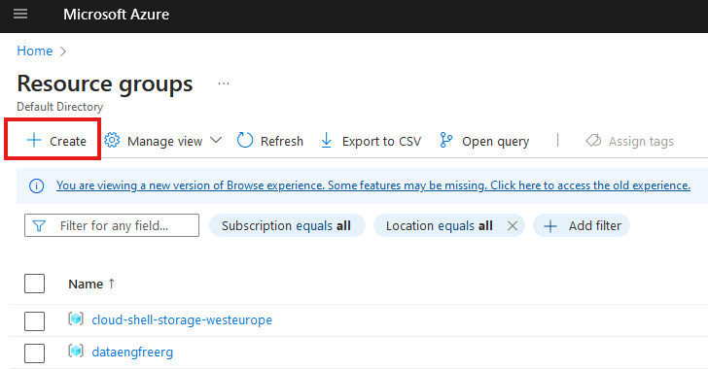
Create Resource Group

Slide 49
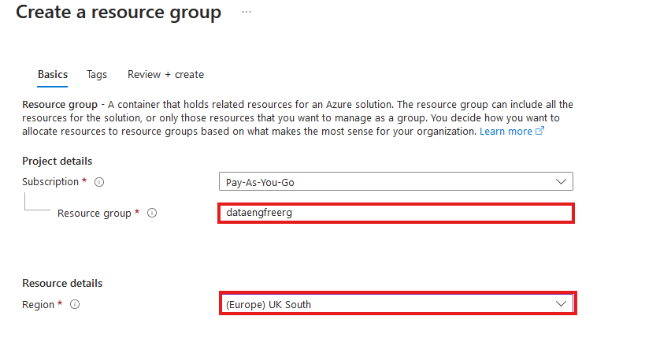
Create Resource Group

Slide 50
Azure CLI Demo

Slide 51
Create storage account
Create in same region as RG
Primary service is ADLS Gen 2
Primary workload Big Data Analytics
Performance: Standard
Redundancy: LRS
Add container > RAW directory

Slide 52
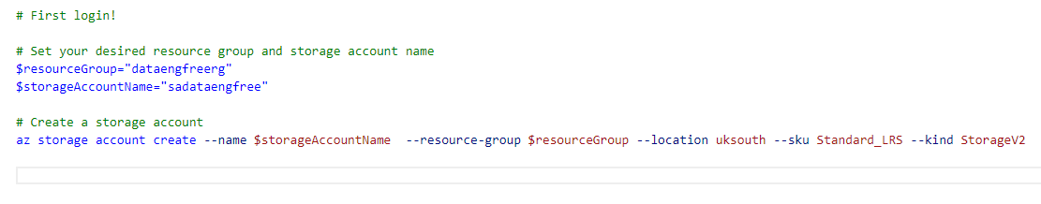
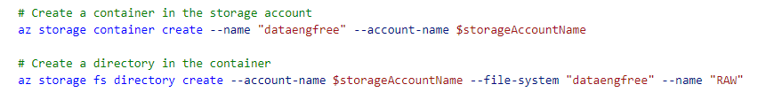
Create storage account

Slide 53
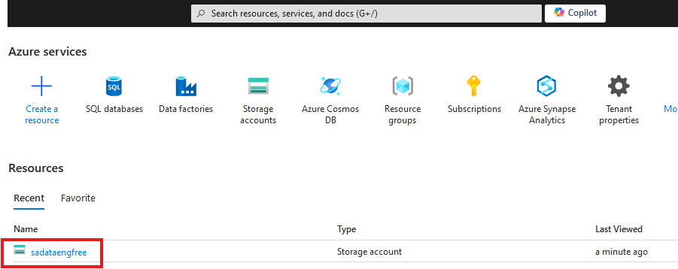

Slide 54
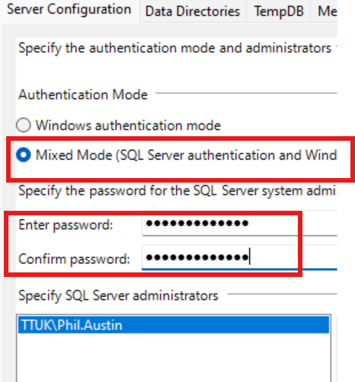

Slide 55
Create Azure Data Factory
Create in same region as RG

Slide 56
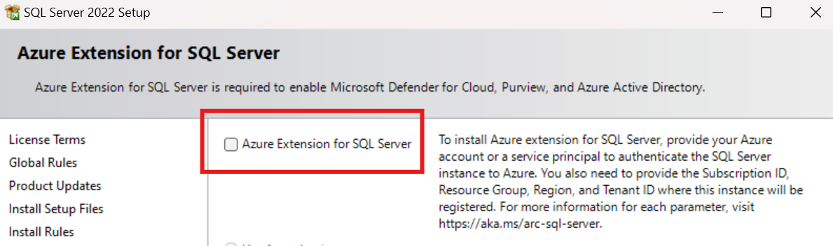
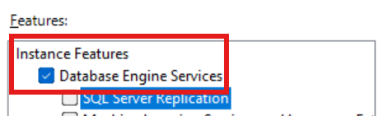
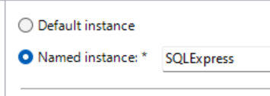

Slide 57
Data & Databases
Concepts to Learn: Data types, databases (SQL and NoSQL), data structures.
Tools/Resources:
Azure SQL Database - free tier available
Cosmos DB: Explore NoSQL databases with a limited free tier on Azure.

Slide 58
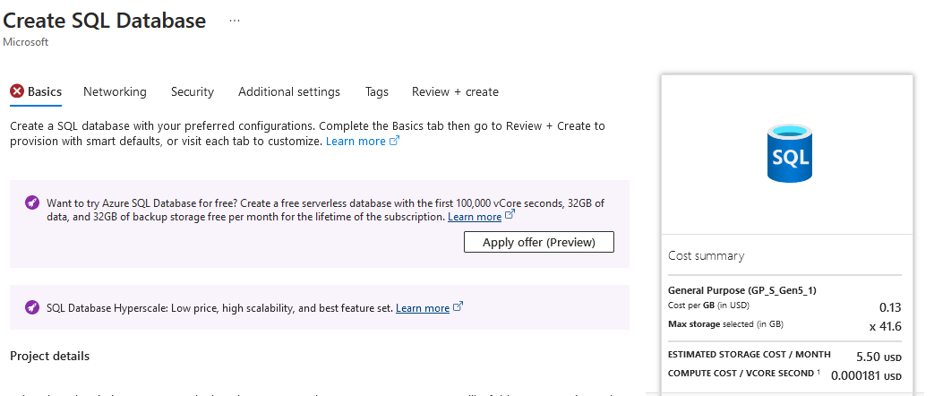

Slide 59
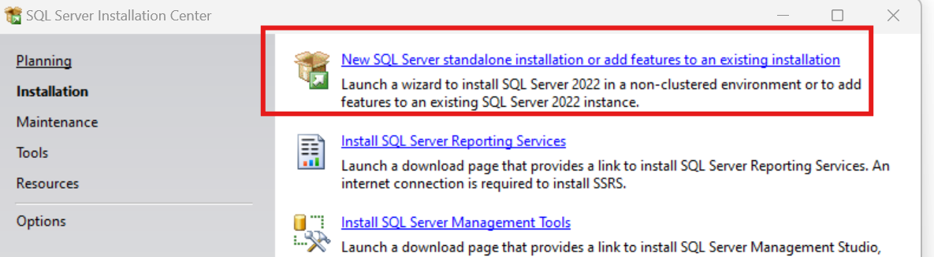
SQL Express!
https://www.microsoft.com/en-us/download/details.aspx?id=104781&lc=1033

Slide 60
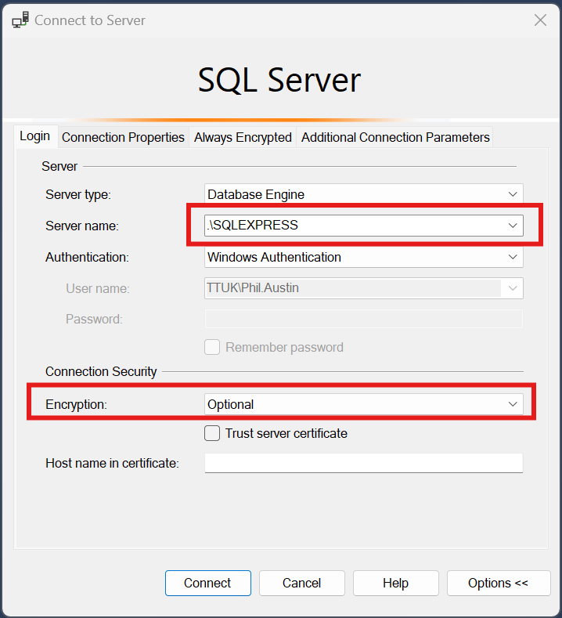

Slide 61
Download JDBC driver: https://repo1.maven.org/maven2/com/microsoft/azure/spark-mssql-connector_2.12/1.2.0/spark-mssql-connector_2.12-1.2.0.jar
Copy jar file to anaconda jars folder

Slide 62
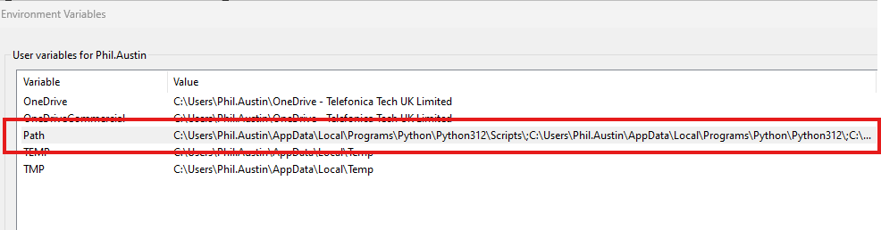
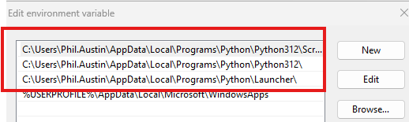
Python pre-reqs

Slide 63
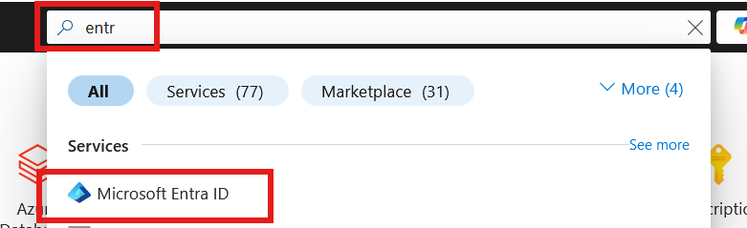
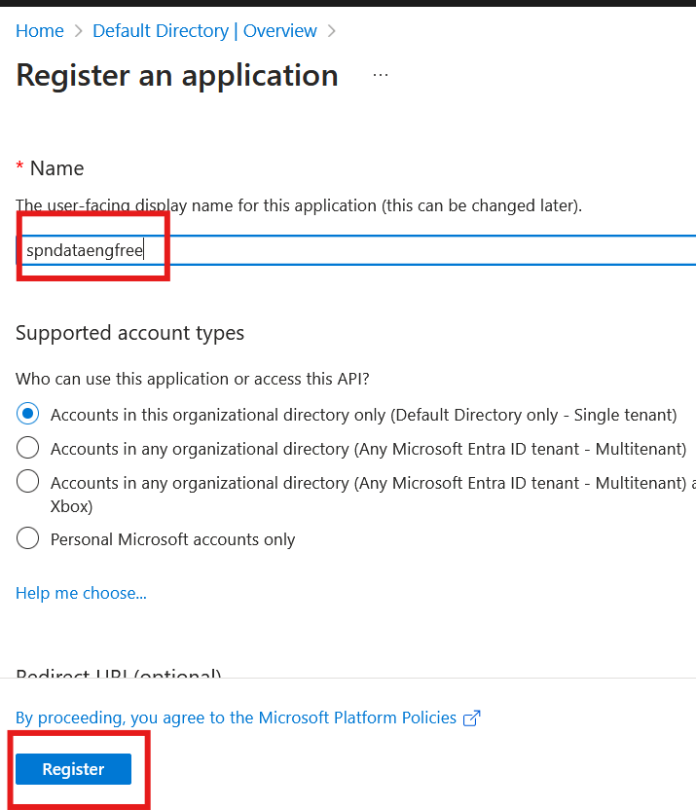

Slide 64
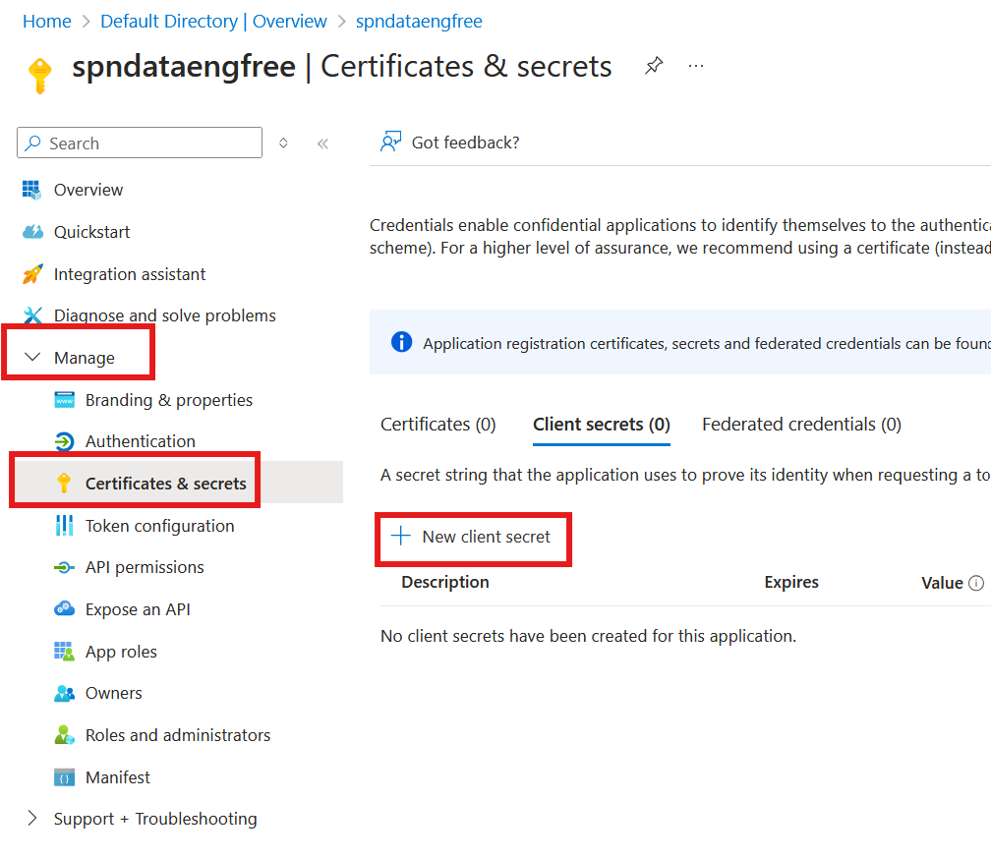


Slide 65



Slide 66


Slide 67

Create storage account

Slide 68

Create storage account

Slide 69

Create storage account

Slide 70



Slide 71


Create Azure Data Factory (ADF)

Slide 72
Create Azure Data Factory (ADF)

Slide 73

Create Azure Data Factory (ADF)

Slide 74


Slide 75


Slide 76


Slide 78
PySpark

